Slide 1
Business and economics

Slide 2
Introduction to business and economics
Business economics is a field of applied economics that studies the financial, organizational, market-related, and environmental issues faced by corporations.
Business economics encompasses subjects such as the concept of
Scarcity
product factors
Distribution
consumption

Slide 3
Conti……
Managerial economics is one important offshoot of business economics.
The National Association for Business Economics (NABE) is the professional association business economists in the U.S.
The Associated Chambers of Commerce and Industry of India
FICCI
Uhyog Bandhu

Slide 4
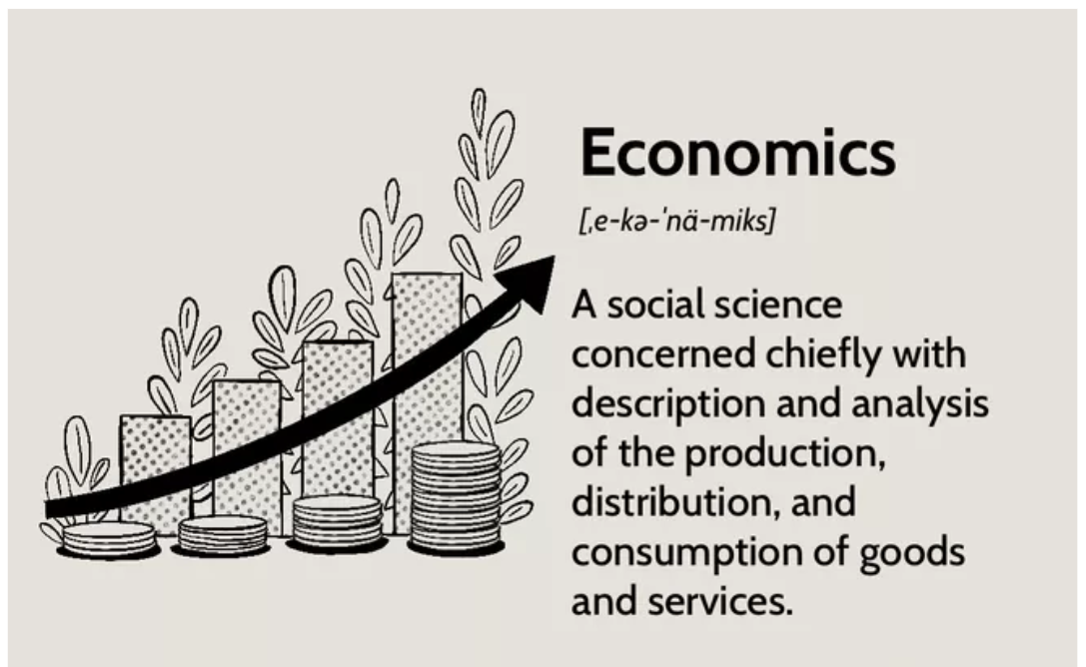

Slide 5
Economics deals with economic problems of the individuals business units, society and that of the globe. Problems such as-
1.Unlimited wants
2.Limited resources
3.Alternative use of resources
4.Problem of choices

Slide 6
Different sets of definitions of economics
Wealth definition (Adam Smith)
Welfare definition (Marshall)
Scarcity definition (Robbins)
Growth definition (Samuelson)

Slide 7
Wealth definition
“Economics is an enquiry into the nature and causes of wealth of nations”.
Wealth is a store of value. In other words, wealth is something that you can enjoy in the future or that can be used to pay future expenses. Wealth is commonly owned by a nation, community, individual or family according to established property rights.

Slide 8
Material definition
“Economics is a study of mankind in the ordinary business of life. It examines that part of individual and social action which is most closely connected with the attainment and use of material requisite of well being”.

Slide 9
Scarcity definition
“Economics is a science that studies human behaviour as a relationship between ends and scarce means which have alternative uses”.

Slide 10
Growth definition
“Economics is a science that studies those activities of man which he undertakes to maximize his satisfaction by making proper use of his scarce means”

Slide 11
Growth?
Economic growth is an increase in the production of goods and services in an economy
Increases in capital goods, labor force, technology, and human capital can all contribute to economic growth
Economic growth is commonly measured in terms of the increase in the aggregated market value of additional goods and services produced, using estimates such as GDP

Slide 12
WHAT IS ECONOMICS?
Economics is the study of how individuals and societies make choices subject to constraints. The need to make choices arises from scarcity. From the perspective of society as a whole, scarcity refers to the limitations placed on the production of goods and services because factors of production are finite.
From the perspective of the individual, scarcity refers to the limitations on the consumption of goods and services because of limited of personal income and wealth.
Definition: Economics is the study of how individuals and societies choose to utilize scarce resources to satisfy virtually unlimited wants.

Slide 13
Conti…….
What are these scarce productive resources?
Productive resources, sometimes called factors of production or productive inputs, are classified into one of four broad categories: land, labor, capital, and entrepreneurial ability.
Land generally refers to all natural resources. Included in this category are wildlife, minerals, timber, water, air, oil and gas deposits, arable land, and mountain scenery.

Slide 14
Conti……
Business economics is the application of economic theory and quantitative methods (mathematics and statistics) to the business decision-making process.
The role of business economics in the decision-making process is (Next PPT- fig-1)
Definition: Business economics is the synthesis of microeconomic theory and quantitative methods to find optimal solutions to business decision-making problems.

Slide 15
Working of Business Economics
Economic Theory
Quantitative Method
Business or Management decision problem
Optimal solutions to specific organizational objectives
(Business Economics)

Slide 16
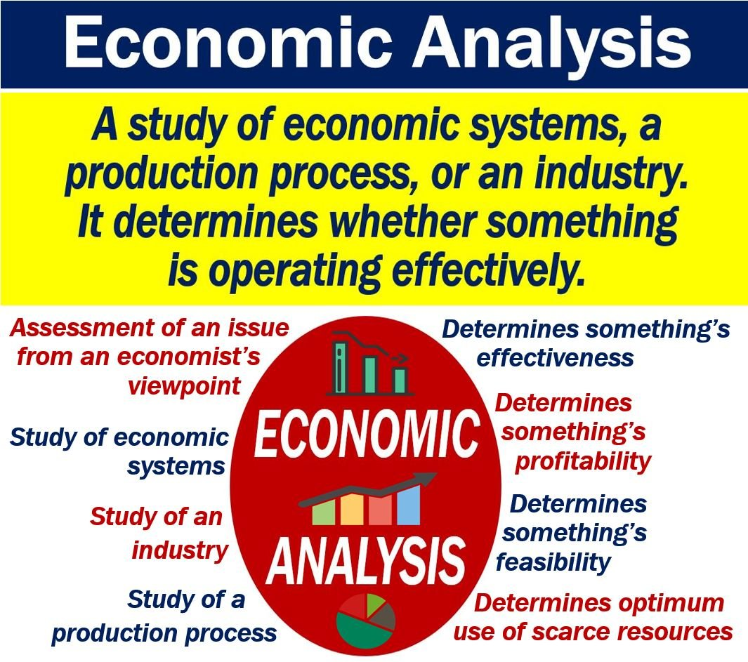

Slide 17
Major types of economic analysis:
Cost-Benefit Analysis
One of the most effective types of economic evaluation is the cost-benefit analysis, also referred to as a benefit-cost analysis.
This is a technique used to determine whether a project or activity is feasible by weighing the monetary cost of doing the project or activity versus the benefits.
A cost-benefit analysis will always compare the cost of the effort against the benefits that result from that effort.

Slide 18
Conti…….
There is a drawback to this analysis as it is difficult to place a monetary value on some activities such as the benefits of increased public safety versus the cost to increase law enforcement presence in major cities. After performing the cost-benefit analysis, a small business owner can make an educated business decision.

Slide 19
Cost-Effective Analysis
In a cost-effective analysis, you weigh the effectiveness of a project against its price. Unlike with cost-benefit analysis.
A low cost doesn’t mean high effectiveness, and the reverse is also true. For example, we’ve determined that installing an automated system that can handle customer orders 24 hours a day in MacDonald, seven days a week, is the cheapest way to boost your incoming orders.
After research, we determine that many calls that come into the automated system are not complete, because callers hang up when they hear the automated voice on the system.
Your market research also indicates that your customers want to speak to a live representative. A cost-effective analysis would tell you that the cheaper route of installing an automated system is not effective in processing more orders. Depending on the type of business you own, you may find that saving money doesn’t result in creating a desirable effect on your business.

Slide 20
Cost-Minimization Analysis
Cost-minimization analysis focuses on finding the cheapest cost to complete a project. This is one of the economic evaluation methods that business owners use when cost savings are at a premium and outweigh all other considerations.
It is also used when there are two or more ways to accomplish the same task. Cost-minimization analysis is most often used in healthcare.
For example, drug manufacturers may compare two drugs that have been shown to produce the same effect in patients, or a pharmaceutical company may implement a cost-minimization analysis, to determine which of two medications that treat the same illness will cost the least amount of money to produce.

Slide 21
Economic analysis doesn’t determines business operations by
Approaching towards Feasibility
Approaching towards Profitability
Approaching towards irregularity
None of the above

Slide 22
The most scientific definition of economics given by
Robins
Marshal
Keynes
All the above

Slide 23
Abundancy of the productive resources vary from one country to another country-
Yes
No

Slide 24
Which of the following is not the productive resources
Labour
Land
Kapital
Profit

Slide 25
Optimal solutions to specific organizational objectives can be achieved mainly with the help of –
Macro economics
Development economics
Business Economics
None of the above

Slide 26
NABE is the professional association in US , known as
National Accreditation for Business Economics
The National Association for Business Economics
National Analogy for Business Economics
All the above

Slide 27
Basic economic problems
What to produce
How to produce
For whom to produce

Slide 28
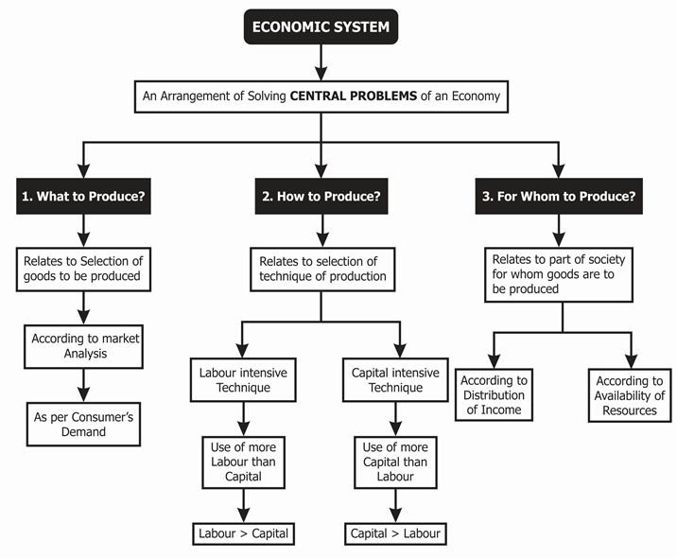

Slide 29
Production possibility curve

Slide 30
What is the Production Possibilities Curve?
Production Possibilities Curve?
• A production possibilities graph (PPG) is a model that shows alternative ways that an economy can use its scarce resources.
• This model graphically demonstrates scarcity, trade-offs, opportunity costs, and efficiency.
It exhibits the various possible combinations of goods and services produced within a specified time with all its resources fully and efficiently employed.

Slide 31
Conti……
In business analysis, the production possibility frontier (PPF) is a curve illustrating the varying amounts of two products that can be produced when both depend on the same finite resources.
The PPF demonstrates that the production of one commodity may increase only if the production of the other commodity decreases.
The PPF is a decision-making tool for managers deciding on the optimum product mix for the company.
The slope of the PPF indicates the opportunity cost of producing one good versus the other good

Slide 32
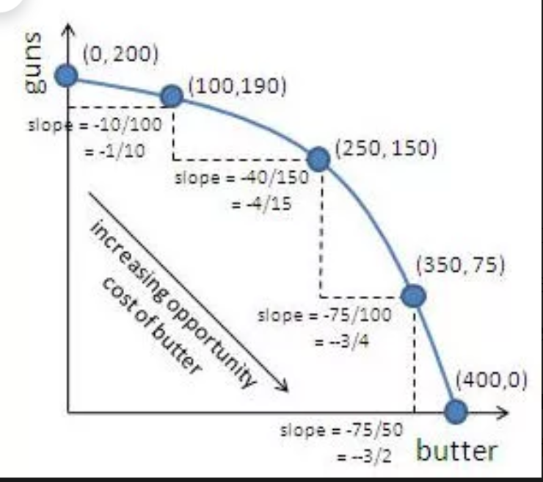

Slide 33
Which is gaining and forgoing commodity for the given production possibility curve?
Slope = marginal forgoing unit /marginal gaining units

Slide 34
Conti……
The magnitude of the slope of the PPF increases, meaning the slope gets steeper, as we move down and to the right along the curve.
This property implies that the opportunity cost of producing butter increases as the economy produces more butter and fewer guns, which is represented by moving down and to the right on the graph.
We are forgoing higher and higher units of Guns to produce more butter, thus it gives us increasing the opportunity cost of producing butter.

Slide 35
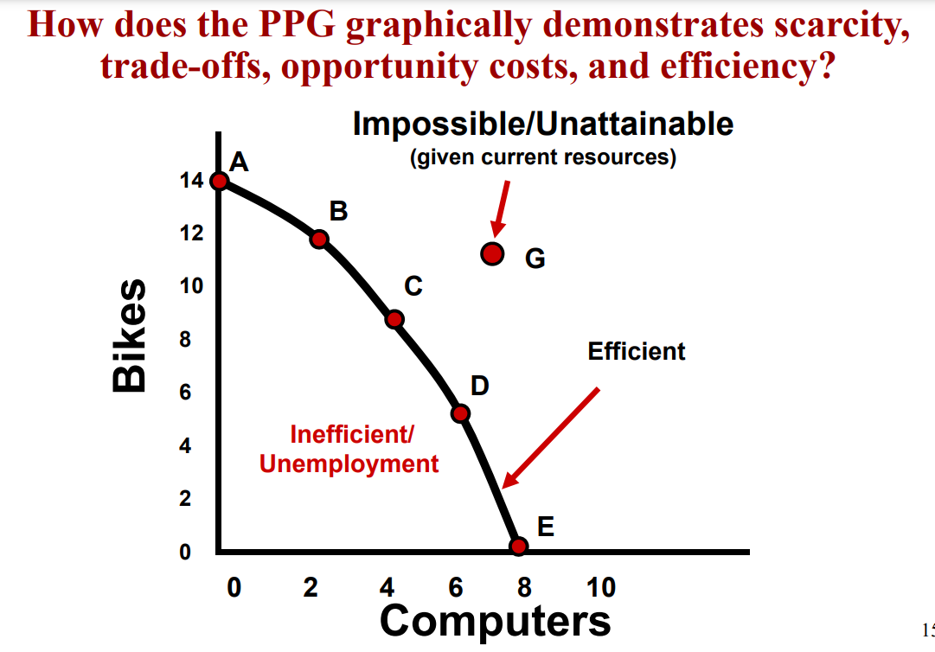

Slide 36
assumptions
The economy is operating at full employment and full production capacity.
The amount of resources available is fixed.
The state of technology does not change throughout production.

Slide 37
Factors influence shift of PPC
Economic growth
Technological advances
Population

Slide 38
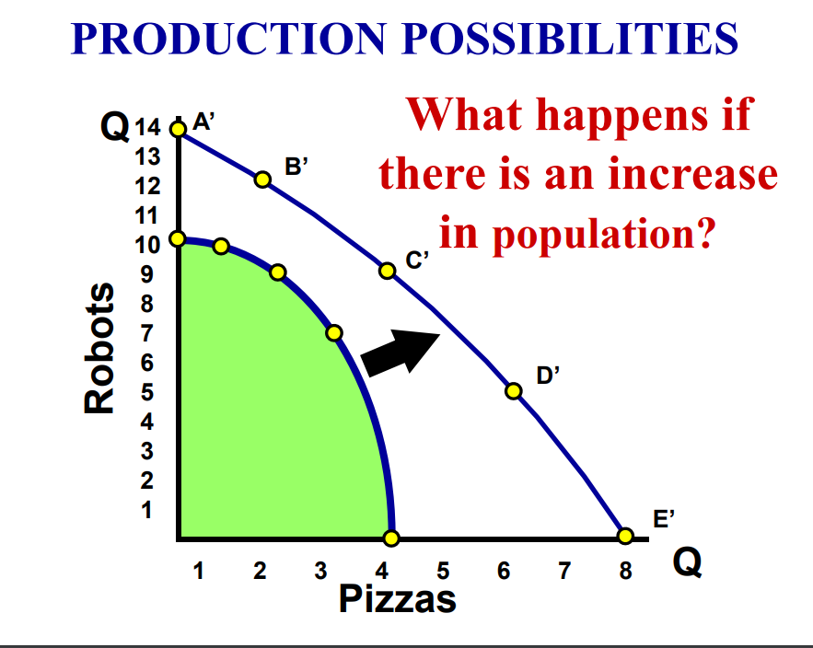

Slide 39
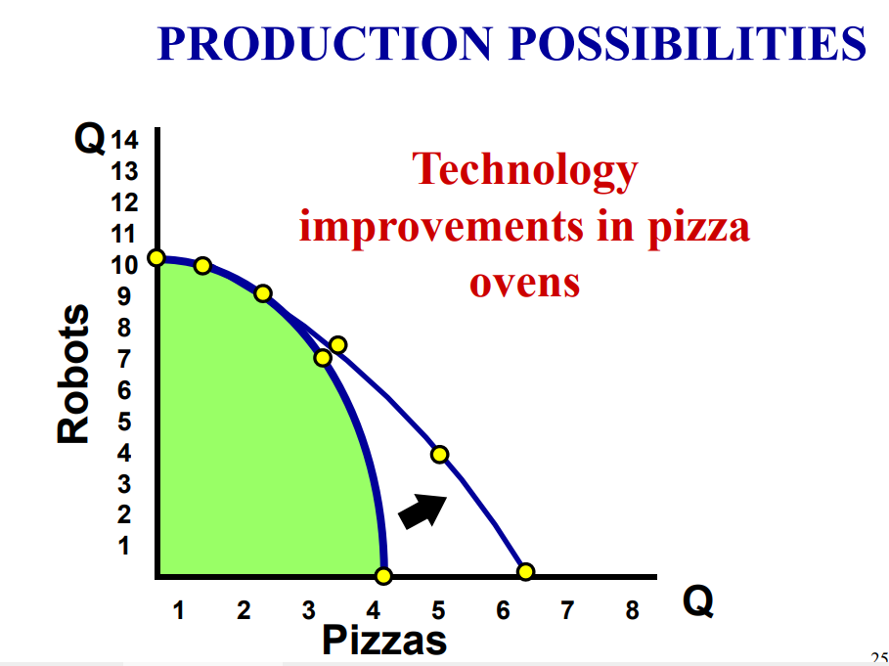

Slide 40
Economic System

Slide 41
Centrally Planned Economy
A centrally planned economy OR command economy, is an economic system in which a central authority, such as a government, makes economic decisions regarding the manufacturing and the distribution of products.
Centrally planned economies are different from market economies, in which such decisions are made by businesses and consumers.

Slide 42
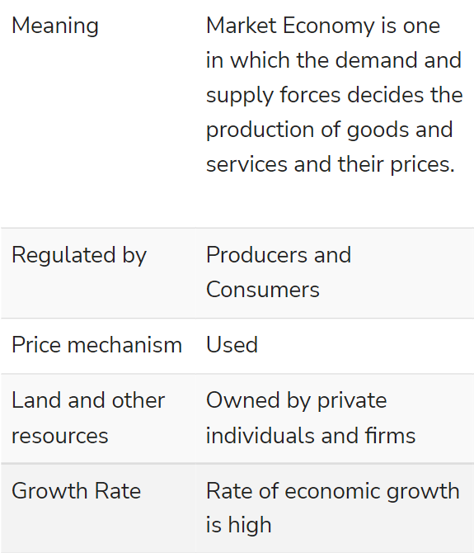
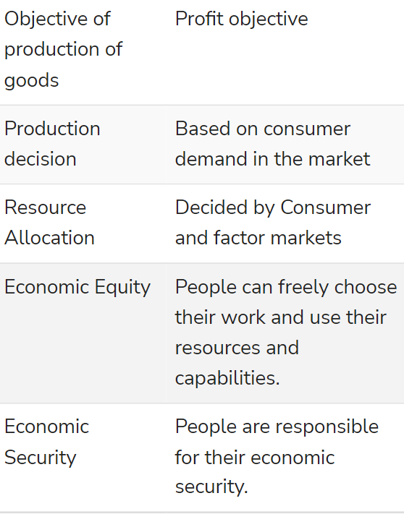
Market economy

Slide 43
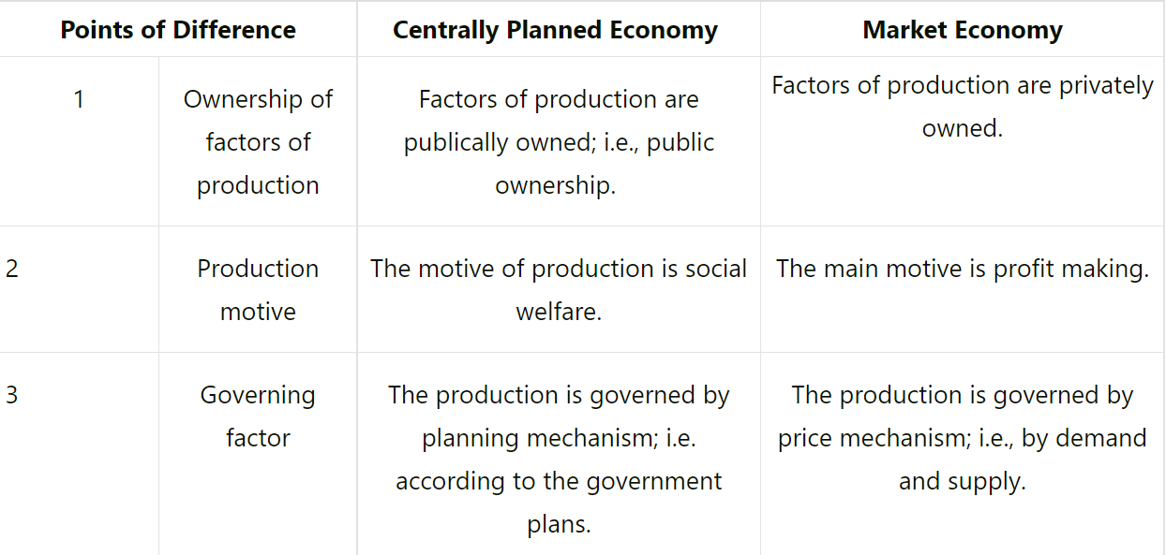
Conti….

Slide 44
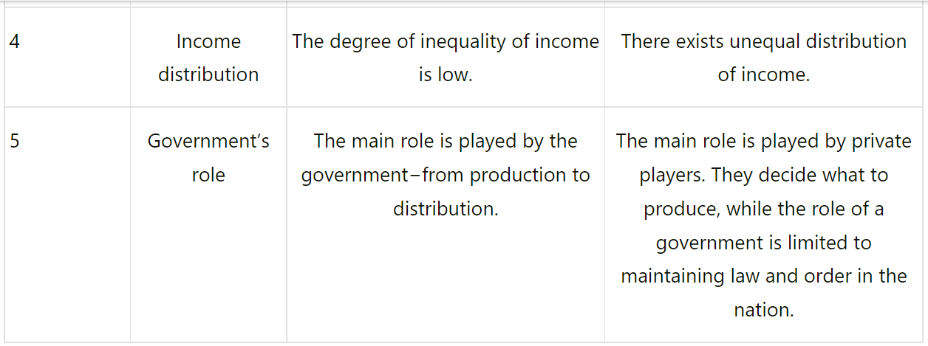
Conti….

Slide 45
Examples of CPE
India
In 1947, after gaining independence from Britain, India formed a centrally-planned economy (also known as a command economy).
Today, India has considered a mixed economy: the private and public sectors co-exist and the country leverages international trade.

Slide 46
CONTI…..
North Korea
North Korea has a command (centralized) economy. The state controls all means of production, and the government sets priorities and emphases in economic development. Since 1954, economic policy has been promulgated through a series of national economic plans.

Slide 47
China
China's economy has grown increasingly faster since the 1978 introduction of economic reforms. ... Since its establishment in 1949 and until the end of 1978, China maintained a centrally planned, or command, economy.

Slide 48
Central Planned Economy
A centrally planned economy is an economy where decisions on what to produce, how to produce, and for whom are taken by the government in a centrally managed bureaucracy.
Central planning is also referred to as a ‘Command economy’ or ‘Communist economy.’ and its detailed features are as follows:

Slide 49
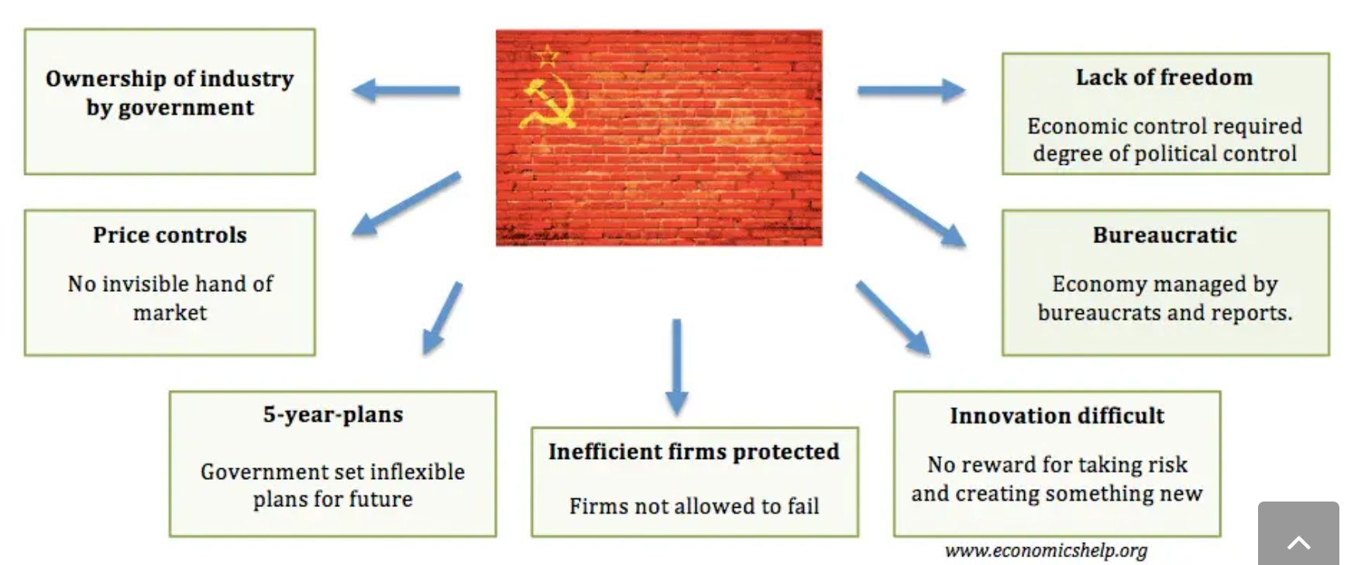

Slide 50
Features of a Centrally planned economy
Ownership by government
Decisions on what to produce, how to produce and how to distribute goods taken at the national bureaucratic level
Prices are usually set by price controls rather than market forces.
Distribution according to ration books.
Production could be planned for five or ten years in advance
Requires more levels of bureaucracy to manage and plan economic decisions
Scope for inefficiency due to lack of incentive
Scope for corruption due to the power of bureaucrats
Often required degree of political control and censorship.

Slide 51
Problems of Central Planning Economies
Governments are poor at predicting future trends.
Lack of incentives when income is guaranteed.
Inflexible- Difficult to respond to shortages and surpluses
Greater scope for corruption
Planned economies often associated with greater political repression
People achieve targets for the sake of it, rather than what is needed. There was a joke in the Soviet Union made by workers “They pretend to pay us, and we pretend to work.” The goal was often to achieve targets, rather than really meet needs, therefore as much effort went into massaging figures and reports and producing socially useful goods.

Slide 52
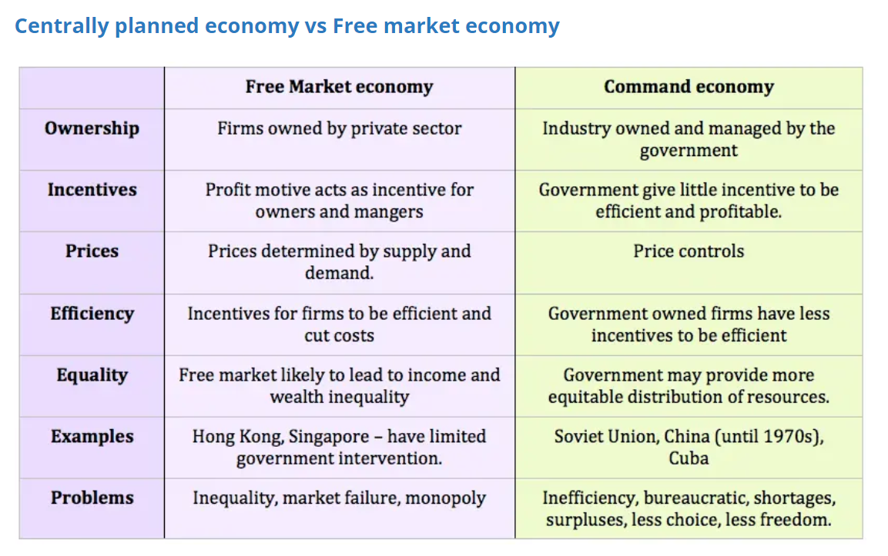

Slide 53
What is a Mixed Economic System?
The mixed economic system is defined as an economic system that combines the elements of a market economy and the elements of a planned economy. It contains both private enterprises and public enterprises. Most modern economies implement a mixed economic system.

Slide 54
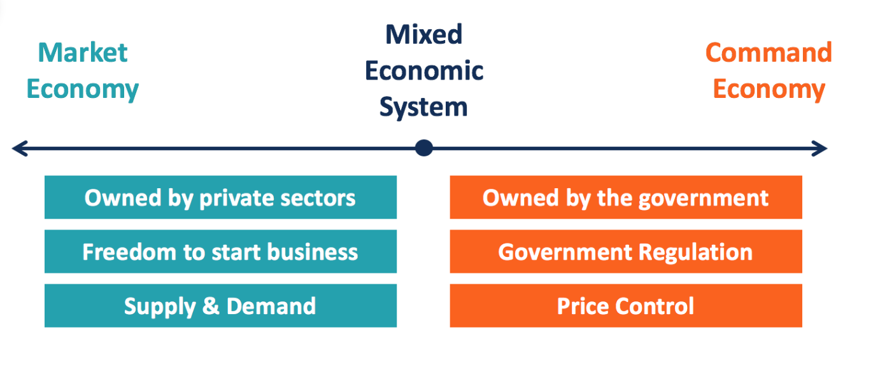

Slide 55
Conti……
A mixed economic system brings the advantages of free markets and also government intervention. However, there are also concerns about the sustainability and efficiency of a mixed economic system.

Slide 56
Benefits of a Mixed Economic System
Combining the features of a market economy and a command economy, a mixed economic system carries advantages from both sides
1. Efficient allocation of resources
Resources are allocated efficiently to where they are needed the most in the private sector. Hence, customers’ needs can be better met.
2. Incentives for innovation and production efficiency
In a free market with competition, the enterprises that can produce more efficiently are rewarded with higher profits. Companies are thus motivated to allocate capital to achieve innovation and efficiency of production. Customers can receive the best value for what they paid for.
3. Government support
The public sector in a mixed economy alleviates the disadvantages of a free market. Private companies might neglect some industries that are essential or bring social welfare because of their low profitability. In a mixed economy, government intervention can support these key industries, such as education, defense, and aerospace, through subsidies or ownership.
The government also takes care of the less competitive companies and disadvantaged individuals.

Slide 57
Drawbacks of a Mixed Economic System
It varies among the different societies at different periods without a fixed standard.
1. Lack of government support
If the economy is given too much freedom, disadvantaged groups will not receive sufficient support from the government. If the economy sees excessive government intervention, enterprises will be disincentivized to produce efficiently. It is crucial for a mixed economy to find a balance.
2. Undue influence from private enterprises
As private enterprises and government intervention are combined in the same system, large corporations may seek to lobby the government. They may influence legislation or activities to benefit themselves.
Government intervention also leads to moral hazards. Private enterprises, especially the large ones, might take more risks since they know they are too big to fail. The government will bail them out if they fall into economic crises.

